Slide 1
Weekly Progress Report LEMS LAB
Amandeep Singh

Slide 2
Week 1 6 June – 12 June 2016
What I Learnt
Calculating First Derivative of 1-D functions using Finite Difference method
Calculating First Derivative of simple 2-D functions like Peaks and Gaussian using Finite Difference method
Calculating Second Derivative of 1-D functions
Calculating Second Derivative of 2-D functions like Peaks and Gaussian
Calculating First and Second Derivatives for above functions with added Noise

Slide 3
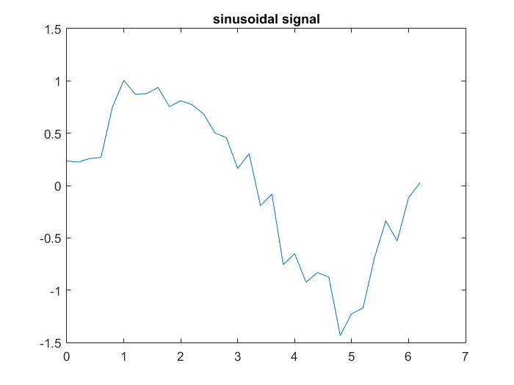
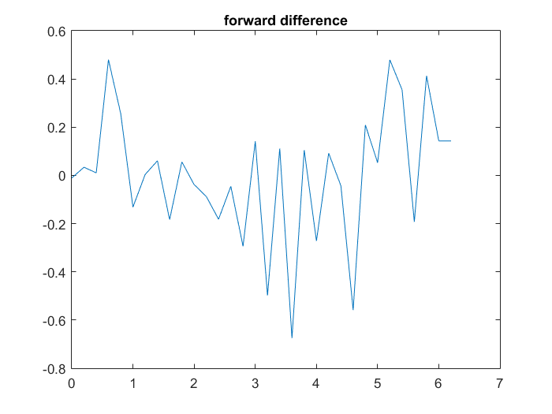
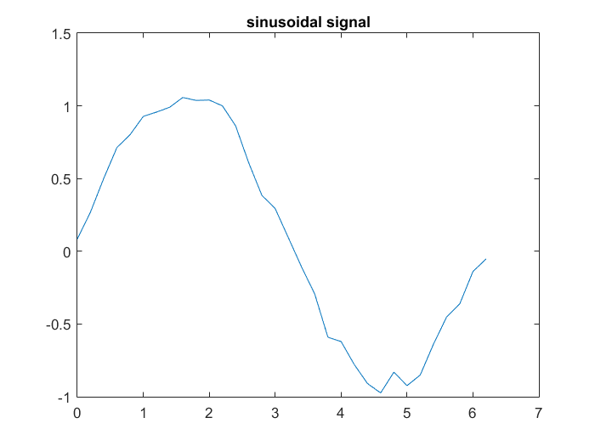
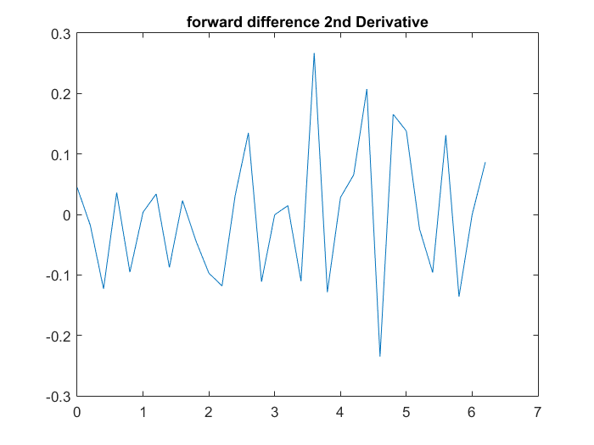
Sinusoidal Function with Noise

Slide 4
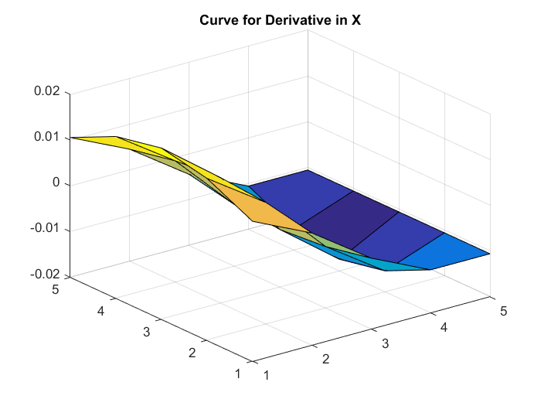
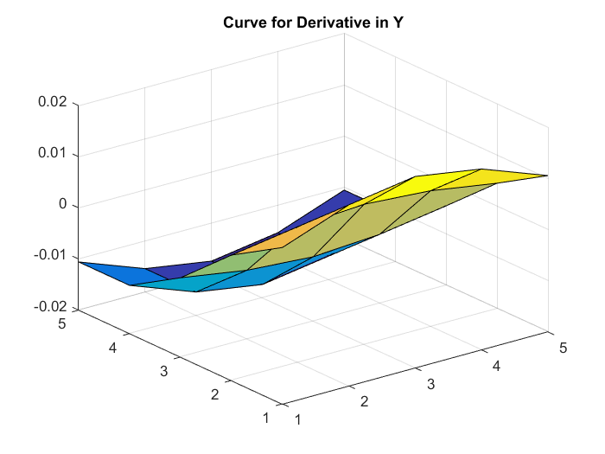
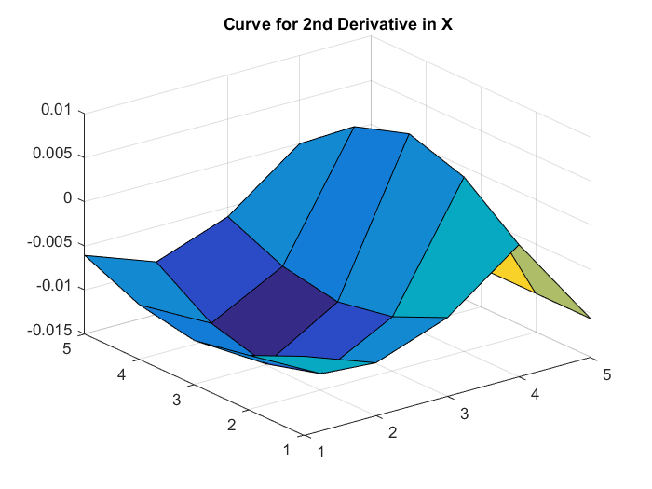
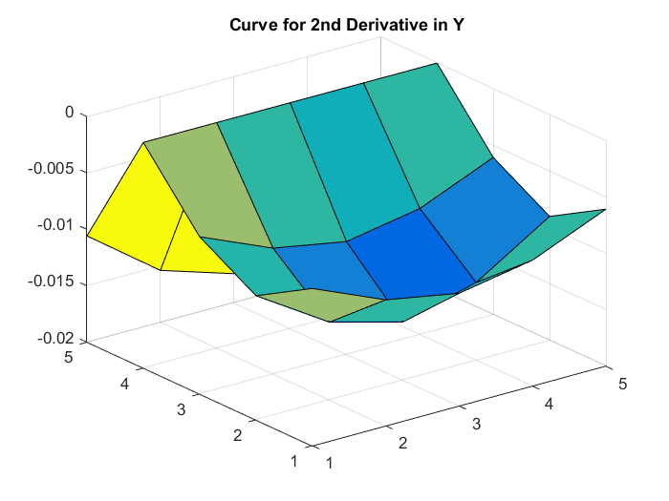
Gaussian Function

Slide 5
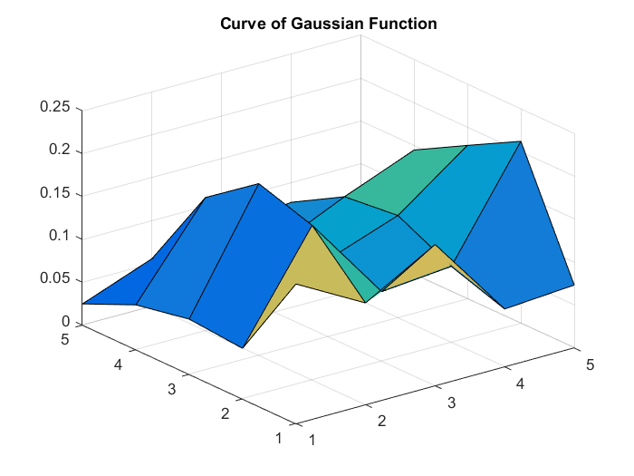
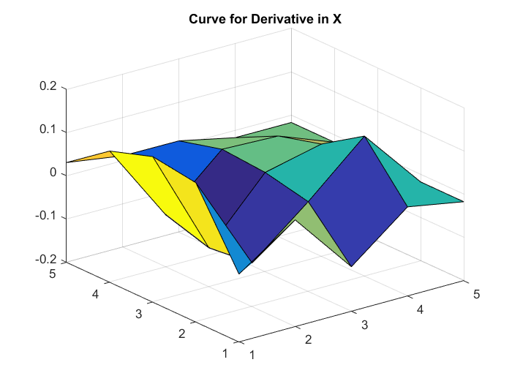
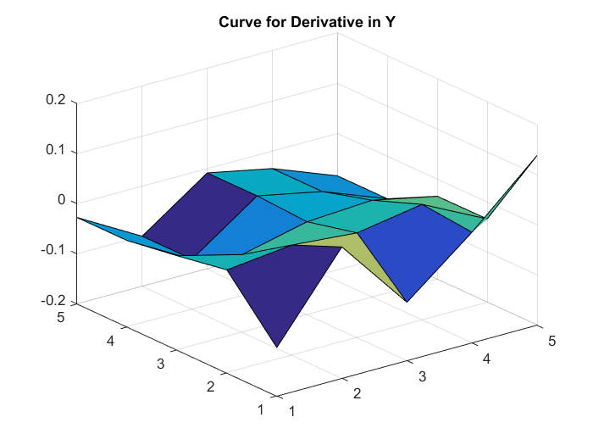
Gaussian with Noise

Slide 6
Week 2 13 June – 19 June
What I Learnt
First and Second Derivative of Grayscale Image
First and Second Derivative of Grayscale Image with Noise
Find Minima and Maxima in 1-D Functions
Find Minima and Maxima in 2-D functions like Peaks and Gaussian
Find Zero Crossing Points using linear interpolation
Find Minima and Maxima in 2-D functions with added Noise
Calculate the Hessian Matrix of Peaks and Gaussian and Grayscale Image

Slide 7
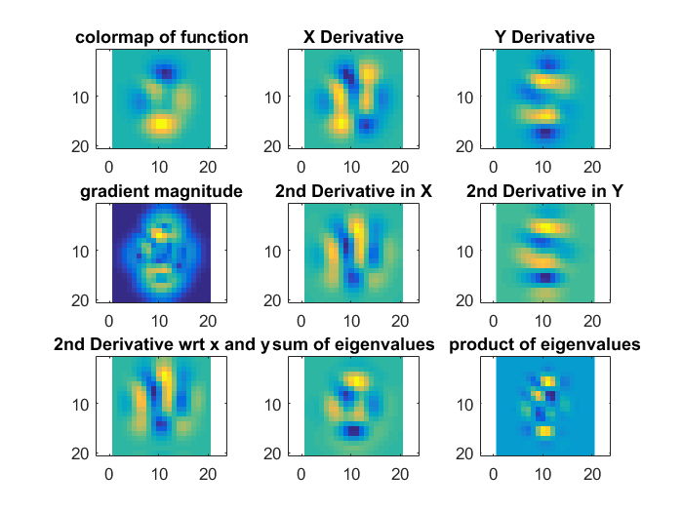
Peaks Function

Slide 8
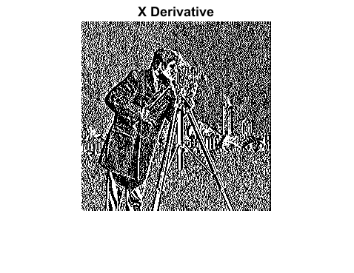
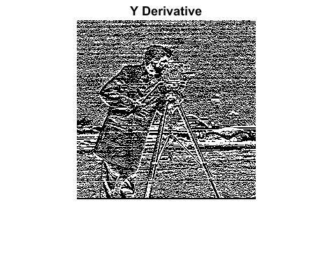
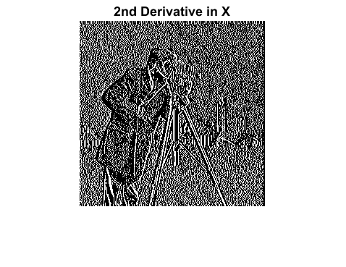
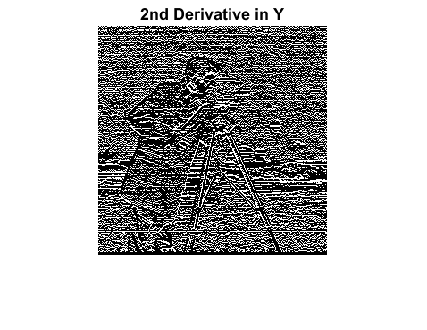
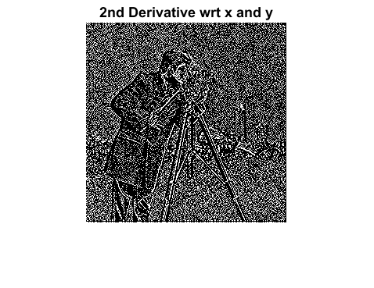
Cameraman Image

Slide 9
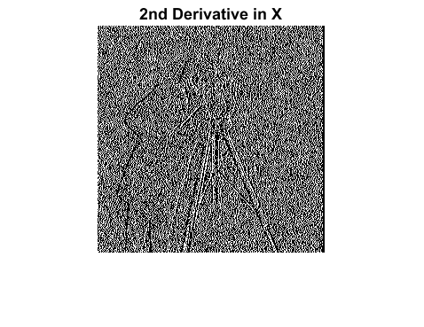
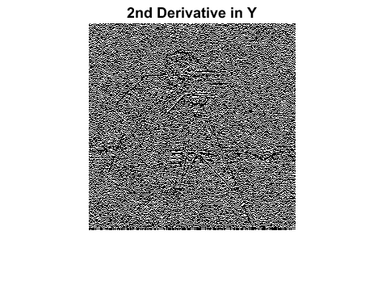
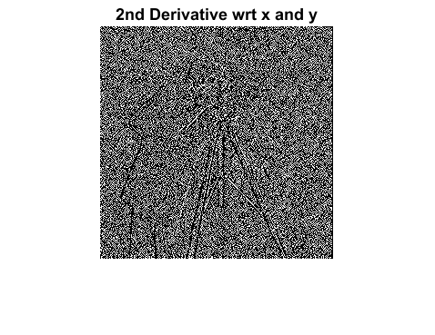
Cameraman Image with Noise

Slide 10
Week 3 20 June – 26 June
What I Learnt
Find Maxima and Minima in images using MATLAB functions
Find Watershed and Watercourse lines in images using MATLAB functions
Find Saddle points in Images considering points where 1) Both Watershed and Watercourse have 0 value
2) Either of them is 0 in a 3x3 neighbourhood
Reconstruct Images using the above three methods

Slide 11
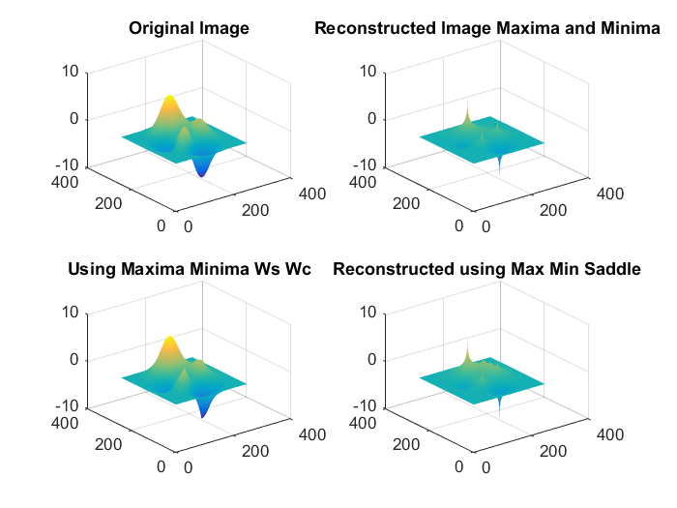
Peaks

Slide 12
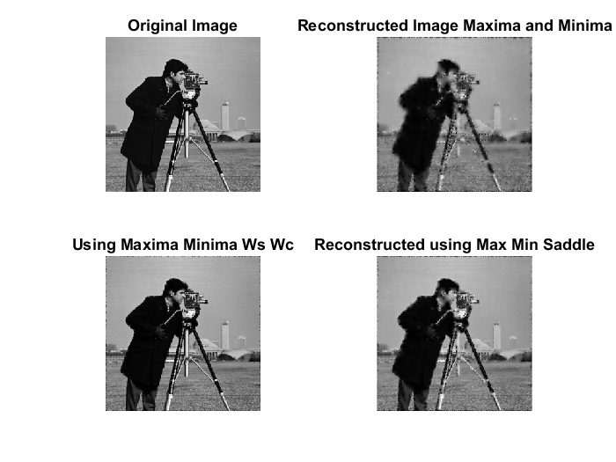
Cameraman Image

Slide 13
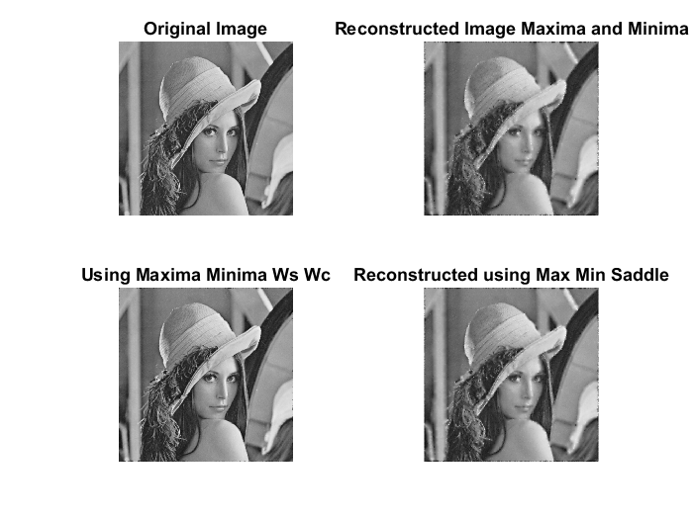
Lena Image

Slide 14
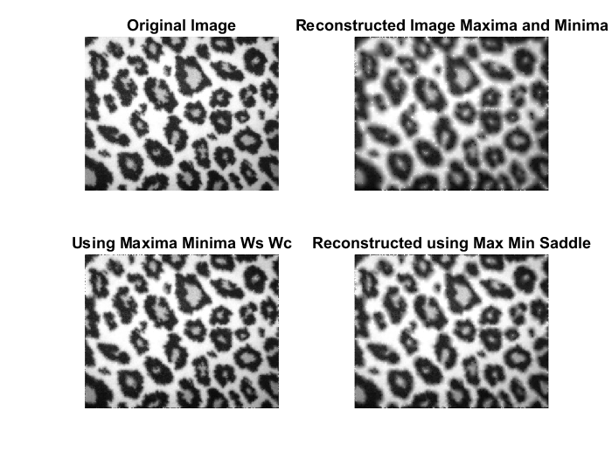
Cheetah Image

Slide 15
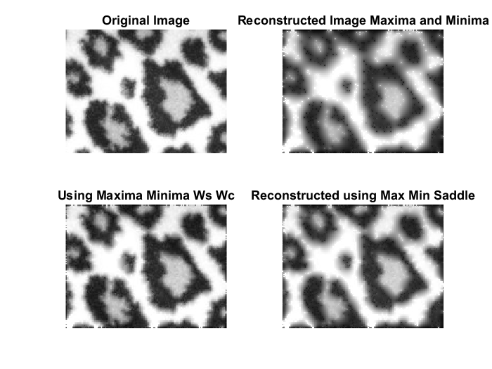
Specific Region in Cheetah Image

Slide 16
Week 4 27 June - 3July
What I learnt
Reconstruction of Images using Edges and Maxima Minima and Edges
VL_SIFT basic functions
Reconstructing some Medical Images

Slide 17
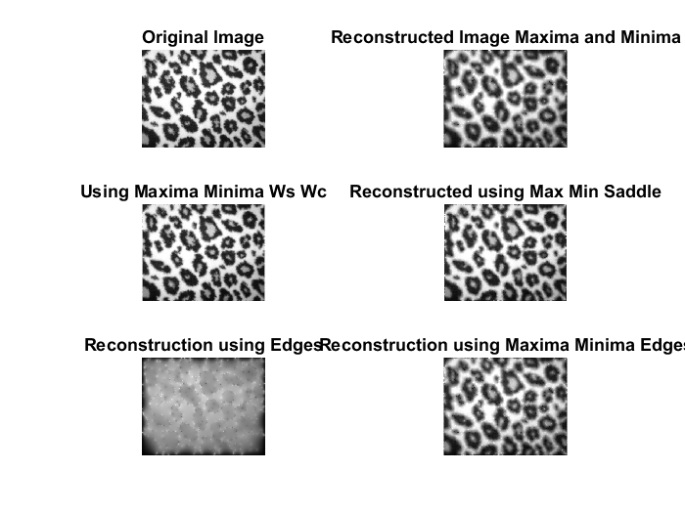
Cheetah Image

Slide 18
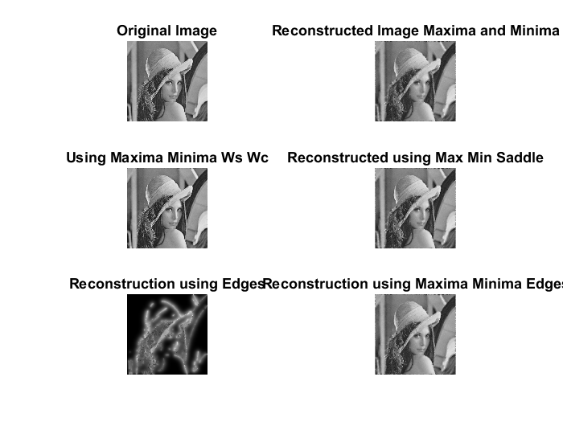
Lena Image

Slide 19
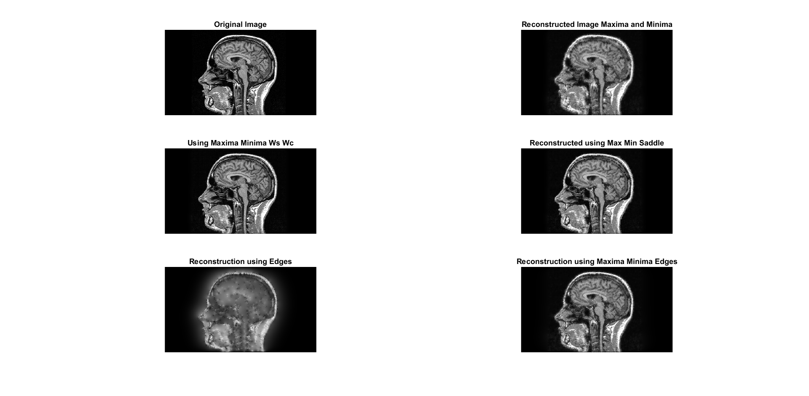
Medical Image 1

Slide 20
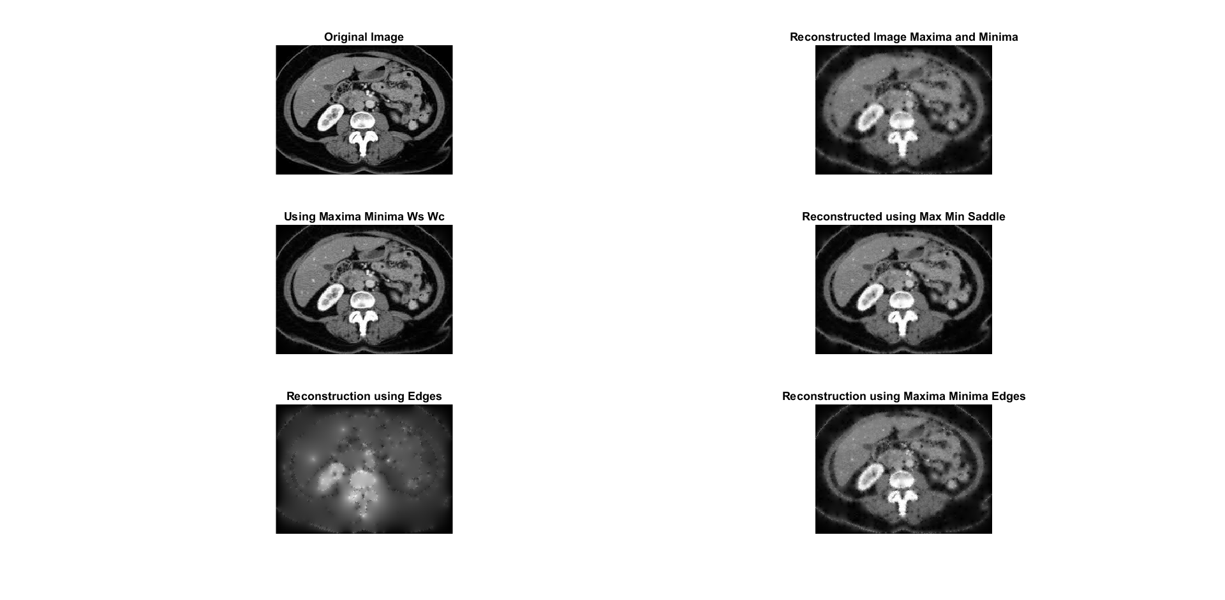
Medical Image 2

Slide 21
Week 5 4 July – 10 July
What I learnt
Vl_Sift finding features and feature descriptors in an image
Matching two images using SIFT features and descriptors using vl_sift library
Matching two images using maxima and minima locations as key points
Creating descriptors using custom scales and orientations but locations of maxima and minima

Slide 22
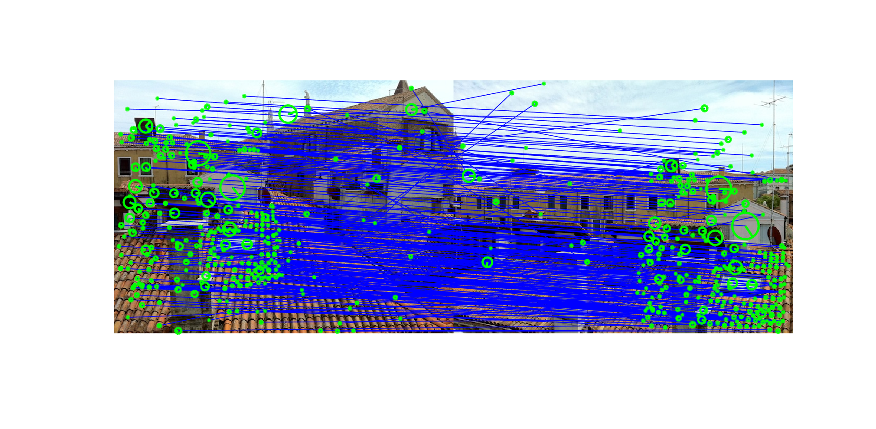
SIFT Matching

Slide 23
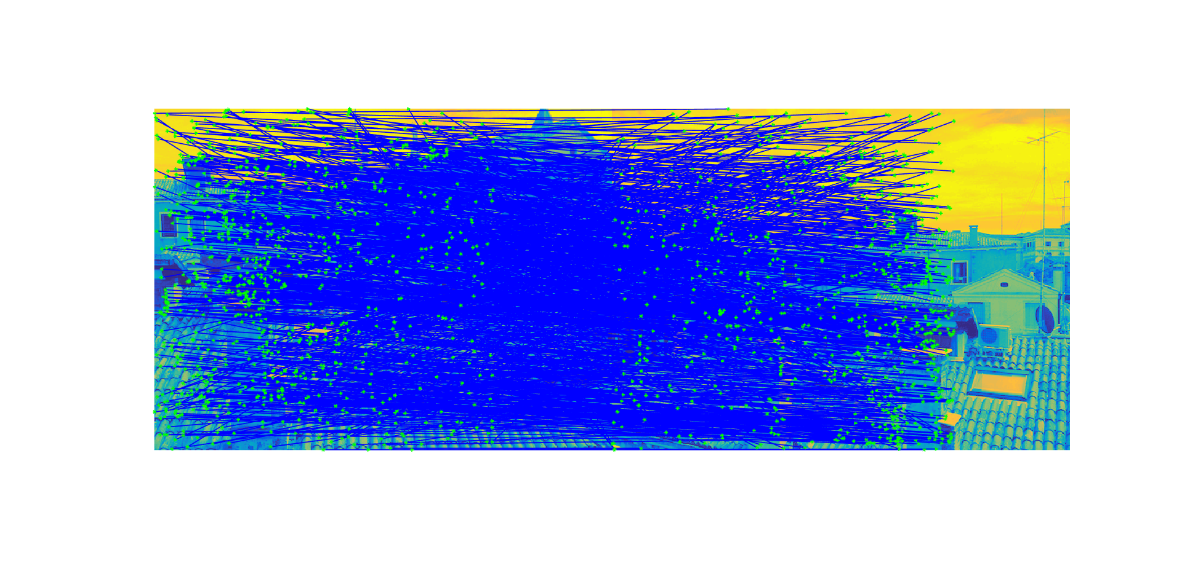
Matching using Maxima

Slide 24
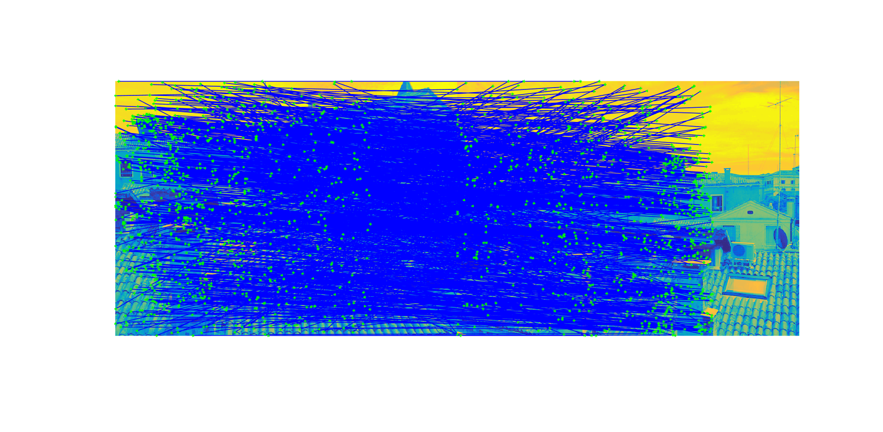
Matching using Minima

Slide 25
Week 6 11 July – 17 July
What I Learnt
Matching images using vl_sift and SIFT key points and descriptors, while applying a Gaussian filter on the images.
Matching images using MAX and MIN points as the key points and applying Gaussian filter to smooth the image and reduce the number of max and min points, to speed up the operation.
Plotting graph of number of critical points in an image with successive Gaussian smoothing
Observing the difference between successive Gaussian filter of similar size but varying in their value of sigma

Slide 26
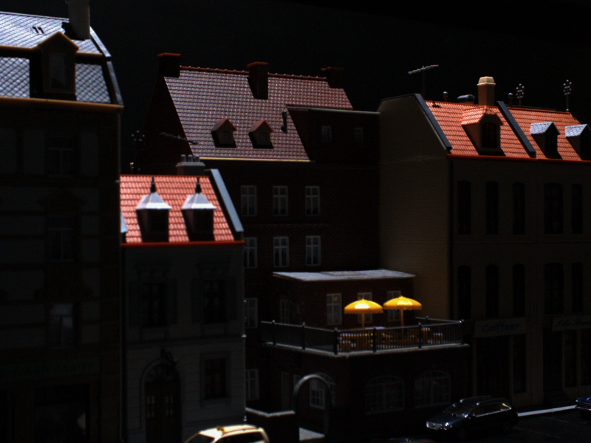
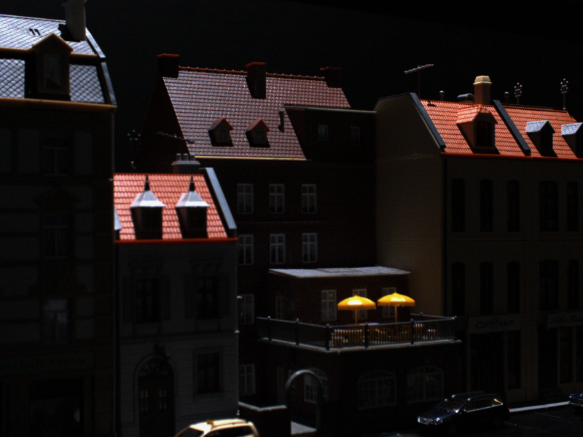
SIFT Matching (applying Gaussian Filter)
Original Image
Matched Image

Slide 27
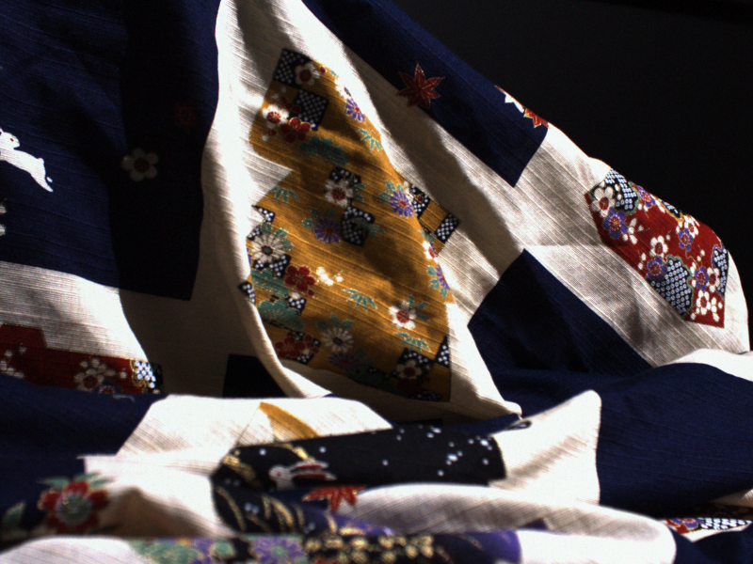
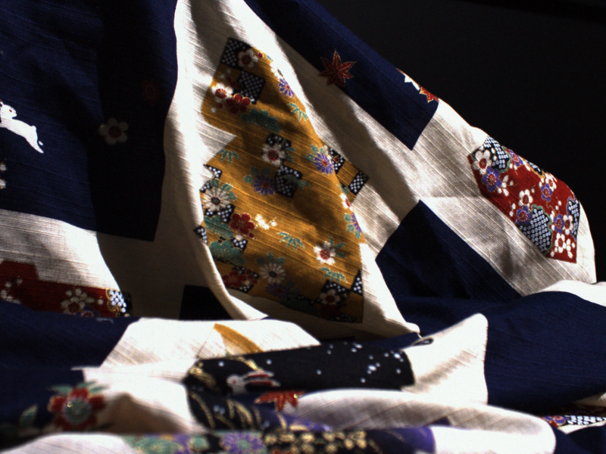
SIFT Matching (applying Gaussian Filter)
Original Image
Matched Image

Slide 28
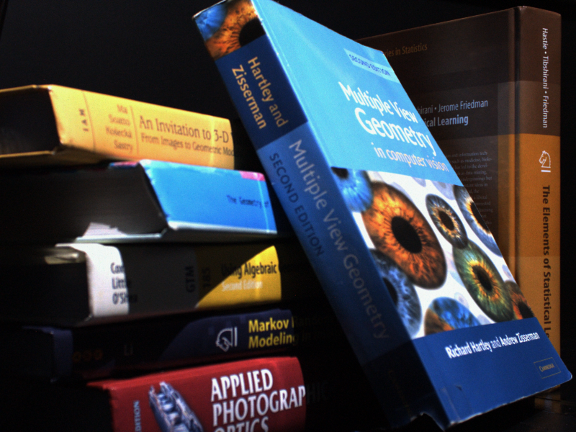

Matching using Maxima (applying Gaussian Filter)
Original Image
Matched Image

Slide 29
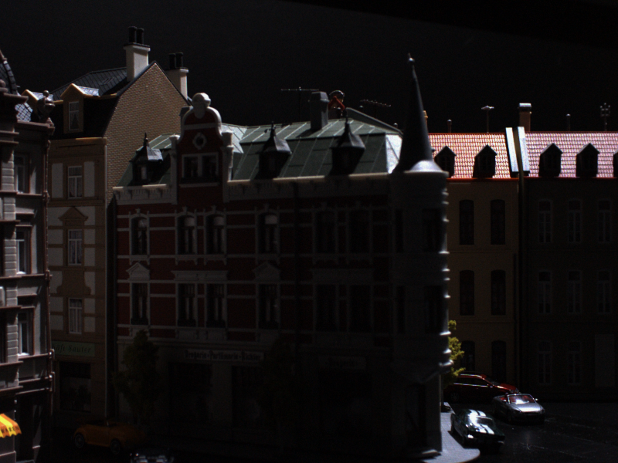
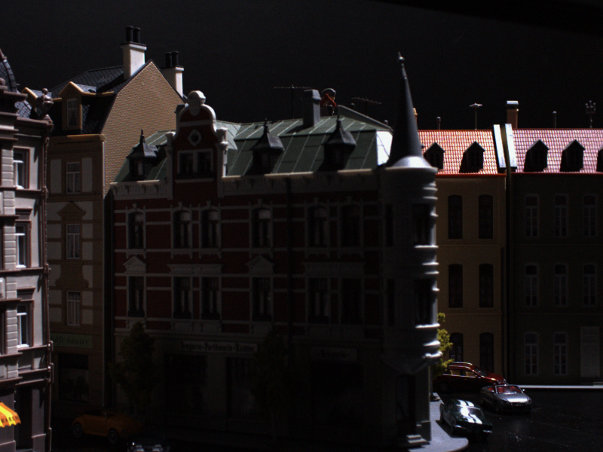
Matching using Maxima (applying Gaussian Filter)
Original Image
Matched Image

Slide 30
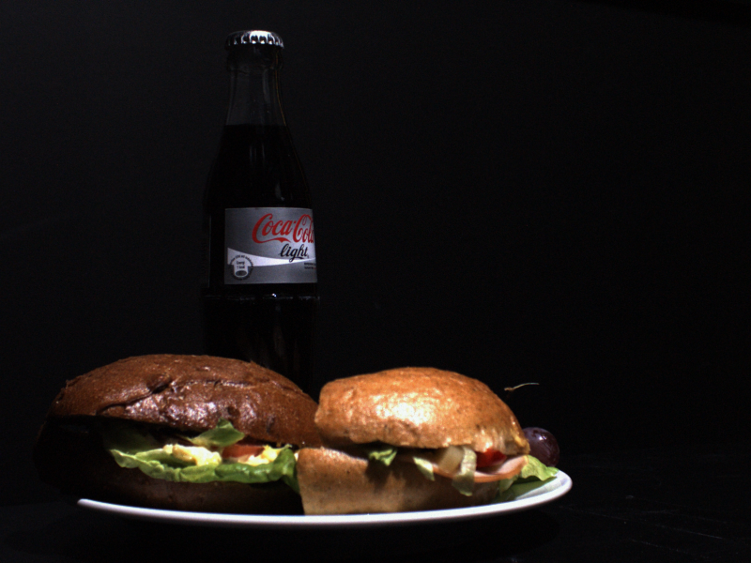
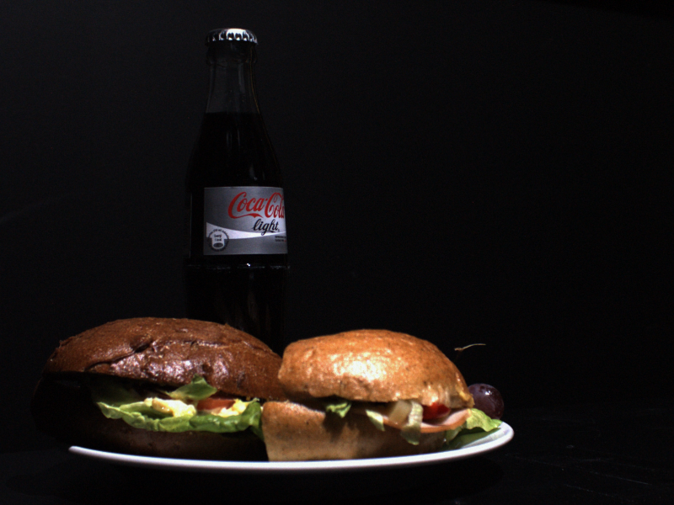
Matching using Minima (applying Gaussian Filter)
Original Image
Matched Image

Slide 31
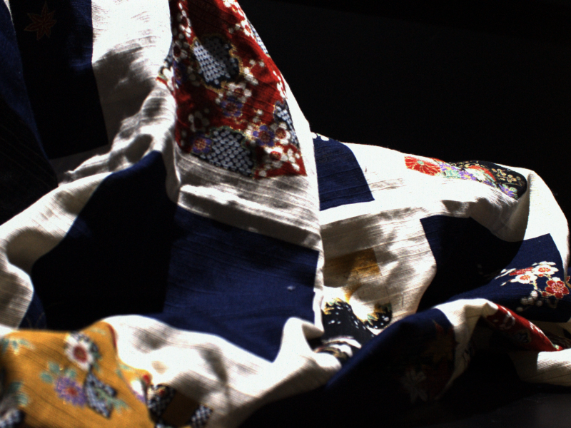
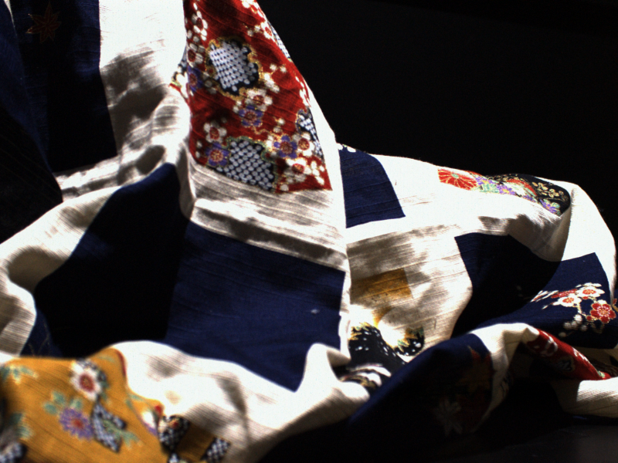
Matching using Minima (applying Gaussian Filter)
Original Image
Matched Image

Slide 32
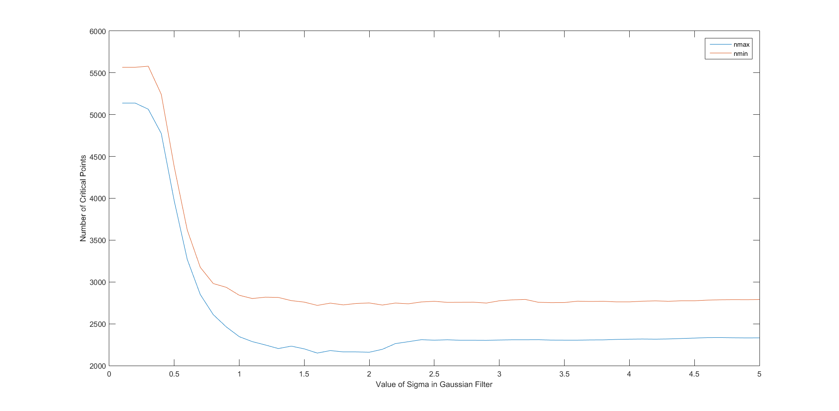
Variation in Number of Critical Points with Gaussian Smoothing (Cameraman)

Slide 33
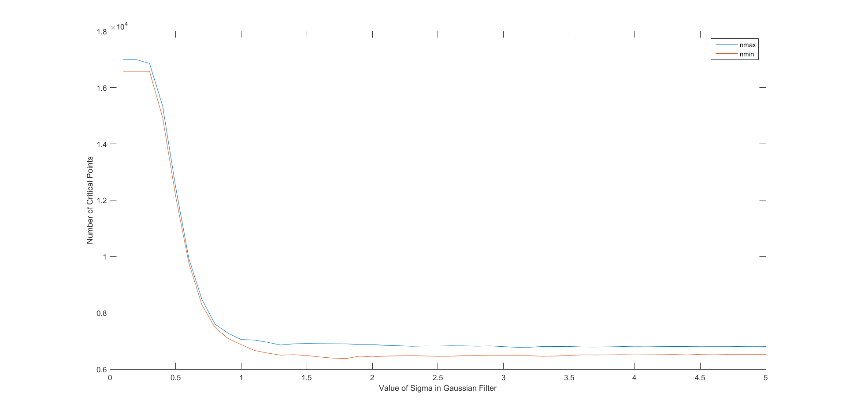
Variation in Number of Critical Points with Gaussian Smoothing (Lena Image)

Slide 34
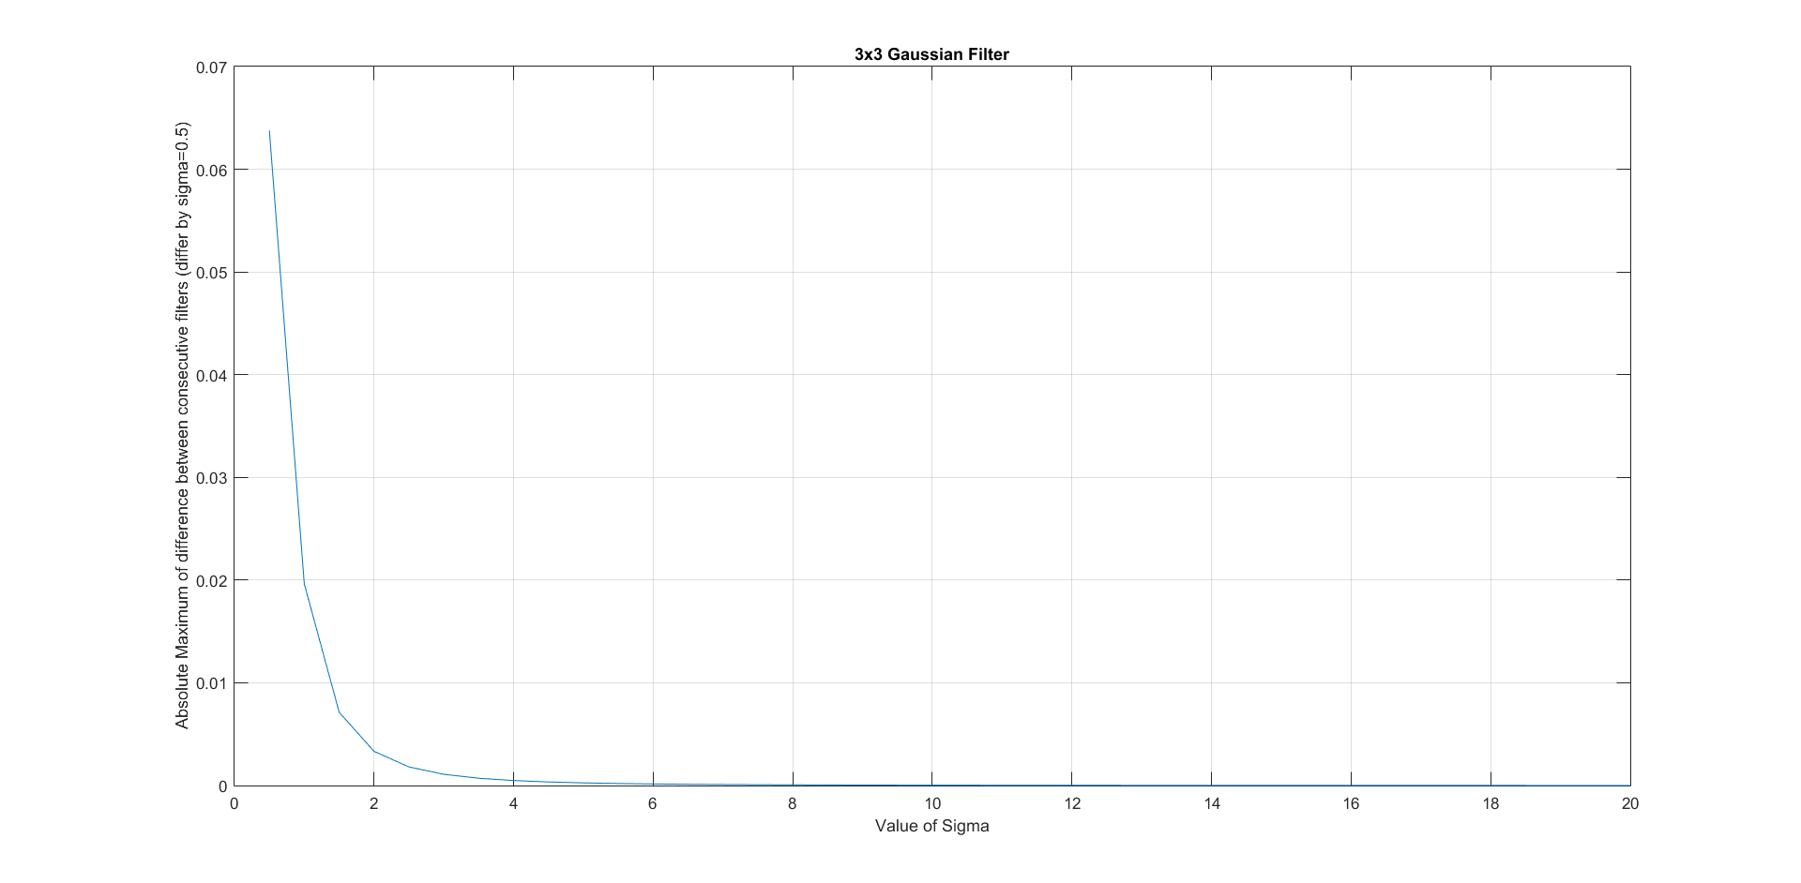
Graph of Difference between Successive Gaussian Filters with varying sigma

Slide 35
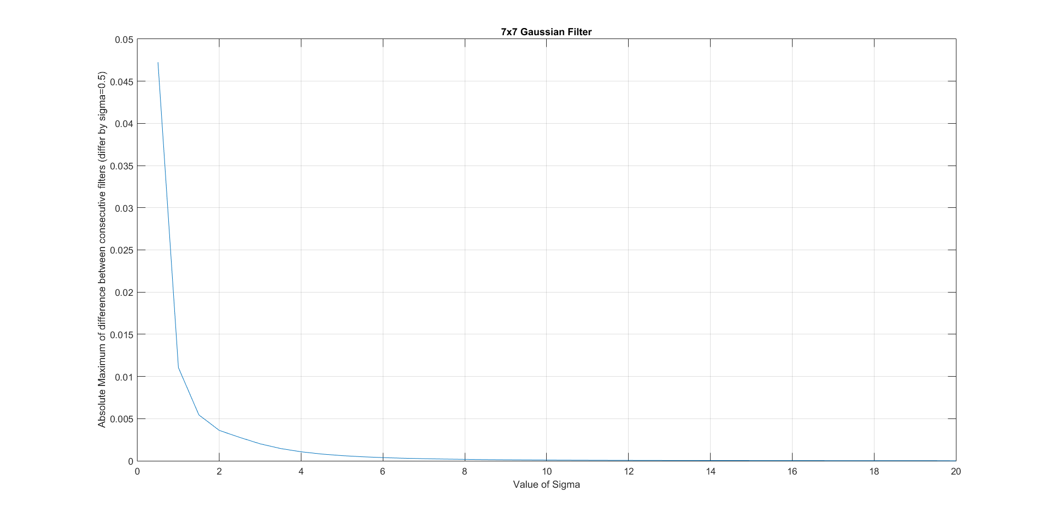
Graph of Difference between Successive Gaussian Filters with varying sigma

Slide 36
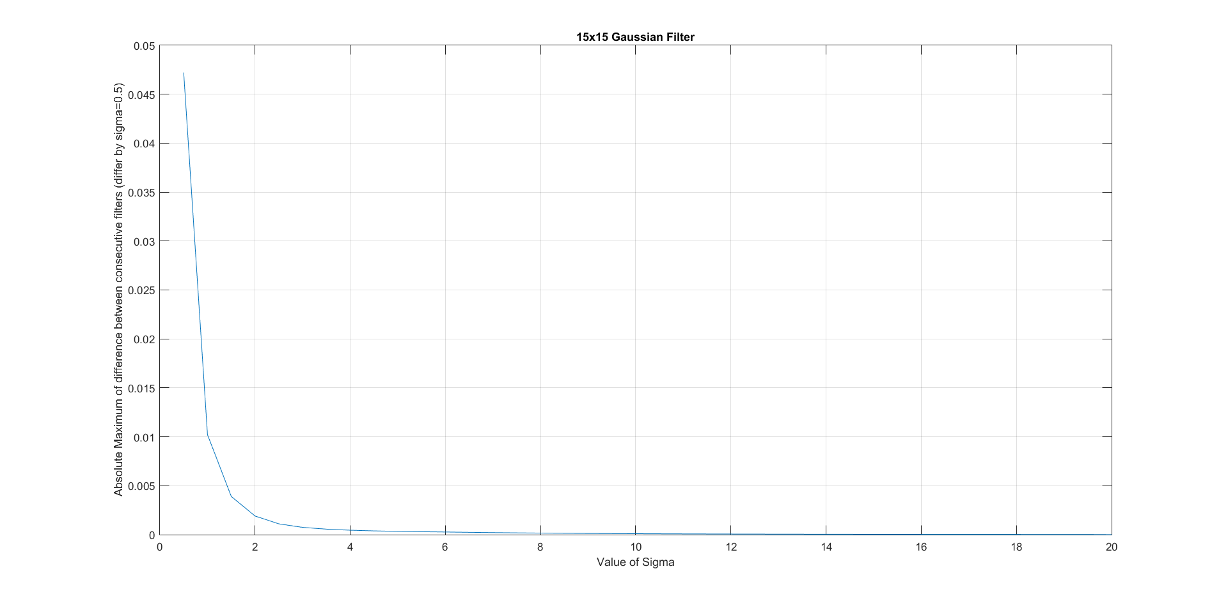
Graph of Difference between Successive Gaussian Filters with varying sigma

Slide 37
Observations
SIFT matching with and without using the Gaussian filter returned the same images.
Matching using maxima and minima as key points with and without applying Gaussian smoothing filter also returned the same images.
I have tested this with 6 query images and Datasets of 300 and 3000 images.

Slide 38
Week 7 18 – 24 July
What I Learnt
Gaussian Filter - Deciding on the value of Sigma as well as the appropriate kernel size for smoothing the image.
Image matching using SIFT and Gaussian smoothing using suitable sigma and kernel size (only the query was smoothed)
Image matching using Minima and Gaussian smoothing using suitable sigma and kernel size (only the query was smoothed)

Slide 39
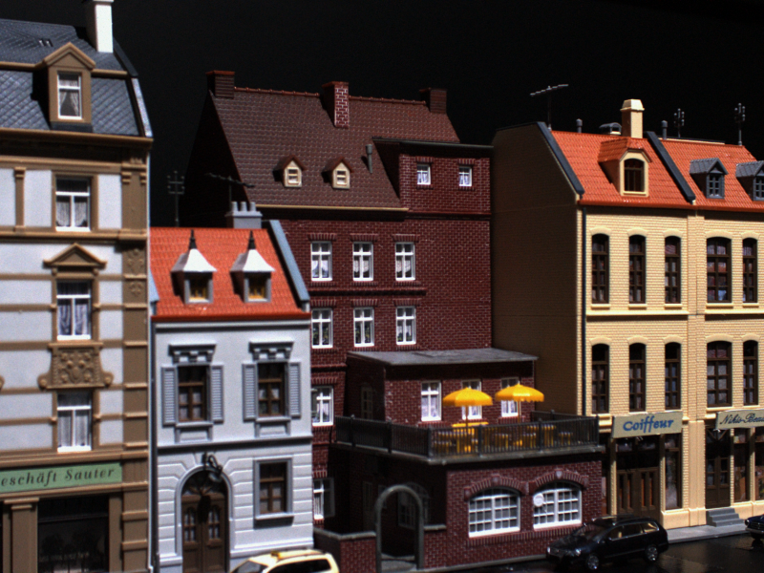
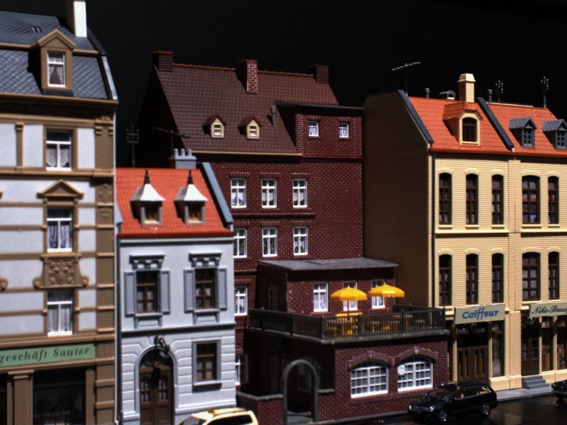
Image Matching using SIFT (Only Query Smoothed)
Original Image
Matched Image

Slide 40


Image Matching using SIFT (Only Query Smoothed)
Original Image
Matched Image

Slide 41


Image Matching using Minima (Only Query Smoothed)
Original Image
Matched Image

Slide 42


Image Matching using Minima (Only Query Smoothed)
Original Image
Matched Image

Slide 43
Week 8 25 – 31 July
What I Learnt
Image Matching using Maxima and Minima, in which both the query and database images were smoothed with a Gaussian filter and connected components were removed by taking their mean.
Computing Compression Ratios of images reconstructed using 1)Maxima, Minima and Saddles 2)Maxima, Minima, Watershed and Watercourse
Removing Maxima and Minima pair from a 1-D Gaussian Function and then reconstructing the graph

Slide 44


Image Matching using Maxima (both query and database Smoothed)
Original Image
Matched Image

Slide 45


Image Matching using Minima (both query and database Smoothed)
Original Image
Matched Image

Slide 46


Reconstruction of 1-D Gaussian without removing Maxima and Minima Pairs

Slide 47


Reconstruction of 1-D Gaussian removing Maxima and Minima Pairs

Slide 48
Week 9 1 – 7 August
What I learnt
Image Matching using Saddle Points, in which both the query and database images were smoothed with a Gaussian filter and connected components were removed by taking their centroid.
Saddle points were taken at intersections of Watershed and Watercourse Lines.
Removing Maxima and Minima pair from a 1-D Gaussian Function and then reconstructing the graph (while adding a padding to the function)

Slide 49
Image Matching using Saddles (both query and database Smoothed)
Original Image
Matched Image

Slide 50
Image Matching using Saddles (both query and database Smoothed)
Original Image
Matched Image

Slide 51

Original Gaussian Function

Slide 52

Reconstructed function without removing max/min pair

Slide 53
Week 10 8 – 12 August
What I learnt
1-D Laplace Equation and Heat Equation solutions
Constructing functions for feature extraction, image matching, image reconstruction
Adding Comments to Code

Slide 54
Compression Ratios for Image Reconstruction
Reconstruction was performed on four images namely – Cameraman, Lena, Cheetah, Onions
The images were smoothed by two Gaussian filters of different sizes.
Compression Ratios were computed for two cases
Reconstruction using maxima, minima and saddle points (taken at intersection of watershed and watercourse lines)
Reconstruction using maxima, minima, watershed and watercourse
Since we need three variables to store a point(X index, Y index and intensity value), the compression ratio is multiplied by 3.

Slide 55
Compression Ratios Table
Image Name |  | Image Points | Maxima | Minima | Watershed | Watercourse | Saddles |  | Comp Ratio Critical Points |  | Points Fixed | Comp Ratio CP + WS + WC
Cameraman |  | 65536 | 4271 | 4169 | 29624 | 30520 | 4334 |  | 0.584747314 |  | 51603 | 2.362197876
Cameraman Filtered [7x7,1] |  | 65536 | 742 | 796 | 14554 | 14146 | 1356 |  | 0.132476807 |  | 27516 | 1.25958252
Cameraman Filtered [12x12,2] |  | 65536 | 157 | 180 | 6722 | 6548 | 294 |  | 0.028884888 |  | 13127 | 0.600906372
Cheetah |  | 72900 | 1778 | 1929 | 23873 | 22847 | 2685 |  | 0.263045267 |  | 43070 | 1.772427984
Cheetah Filtered [7x7,1] |  | 72900 | 309 | 416 | 12430 | 9907 | 650 |  | 0.056584362 |  | 21728 | 0.894156379
Cheetah Filtered [12x12,2] |  | 72900 | 107 | 141 | 6986 | 5768 | 211 |  | 0.018888889 |  | 12666 | 0.521234568
Lena |  | 262144 | 14488 | 14055 | 115291 | 116303 | 15868 |  | 0.508243561 |  | 199462 | 2.282661438
Lena Filtered [7x7,1] |  | 262144 | 2172 | 2189 | 51673 | 50662 | 4079 |  | 0.096588135 |  | 98034 | 1.121910095
Lena Filtered [12x12,2] |  | 262144 | 477 | 569 | 27340 | 24544 | 972 |  | 0.023094177 |  | 51053 | 0.584255219
Onion |  | 18225 | 433 | 426 | 5538 | 5484 | 626 |  | 0.244444444 |  | 10182 | 1.676049383
Onion Filtered [7x7,1] |  | 18225 | 112 | 113 | 2912 | 2885 | 184 |  | 0.067325103 |  | 5660 | 0.931687243

Slide 56
Image Matching Results
We have used the Robot Point Feature Dataset for the image matching experiments
The images are of Scenes 1-6, and have a resolution of 600x800.
Each scene has images of the same object taken from 119 different poses and further, each pose has 19 different levels of illumination.
There are two cases
Query smoothed using Gaussian filter, Database image not filtered
Both Query and Database smoothed with Gaussian Filtered

Slide 57
SIFT Matching - I
Query filtered using Gaussian filter of size 12x12, sigma=2, Database image not filtered
Database Images – 300 (50 from each of 6 scenes)
Query Images – 18 ( 3 from each scene)
Time Taken to Run – 3 hours
Success Rate (Counting image from same scene as positive match) – 100%
Success Rate (Counting image from same pose and differing in illumination level by +/- 3) – 28.5%

Slide 58
Result
Query
Retrieved

Slide 59
SIFT Matching - II
Query and Database image smoothed using Gaussian filter of size 15x15, sigma=2
Database Images – 300 (50 from each of 6 scenes)
Query Images – 18 ( 3 from each scene)
Time Taken to Run – 3 hours
Success Rate (Counting image from same scene as positive match) – 100%
Success Rate (Counting image from same pose and differing in illumination level by +/- 3) – 44.44%

Slide 60
Result
Query
Retrieved

Slide 61
Maxima Matching - I
Query and Database image smoothed using Gaussian filter of size 15x15, sigma=5
Database Images – 300 (50 from each of 6 scenes)
Query Images – 18 ( 3 from each scene)
Time Taken to Run – 4 hours
Success Rate (Counting image from same scene as positive match) – 100%
Success Rate (Counting image from same pose and differing in illumination level by +/- 3) – 83.3%

Slide 62


Result
Query
Retrieved

Slide 63
Minima Matching - I
Query filtered using Gaussian filter of size 12x12, sigma=2, Database image not filtered
Database Images – 300 (50 from each scene)
Query Images – 18 ( 3 from each scene)
Time Taken to Run – 4 hours
Success Rate (Counting image from same scene as positive match) – 94.4%
Success Rate (Counting image from same pose and differing in illumination level by +/- 3) – 63.6%

Slide 64
Result
Query
Retrieved

Slide 65
Maxima Matching - II
Query filtered using Gaussian filter of size 12x12, sigma=2, Database image not filtered
Connected Components removed by taking mean
Database Images – 300 (50 from each scene)
Query Images – 18 ( 3 from each scene)
Time Taken to Run – 4 hours
Success Rate (Counting image from same scene as positive match) – 55.5%
Success Rate (Counting image from same pose and differing in illumination level by +/- 3) – 14.2%

Slide 66

Result
Query
Retrieved

Slide 67
Minima Matching - II
Query & Database image filtered using Gaussian filter of size 15x15, sigma=2
Connected Components removed by taking mean
Database Images – 300 (50 from each scene)
Query Images – 18 ( 3 from each scene)
Time Taken to Run – 4 hours
Success Rate (Counting image from same scene as positive match) –100%
Success Rate (Counting image from same pose and differing in illumination level by +/- 3) –38.4%

Slide 68
Result
Query
Retrieved

Slide 69
Maxima Matching - III
Query & Database image filtered using Gaussian filter of size 15x15, sigma=2
Connected Components removed by taking mean
Database Images – 300 (50 from each scene)
Query Images – 18 ( 3 from each scene)
Time Taken to Run – 4 hours
Success Rate (Counting image from same scene as positive match) –100%
Success Rate (Counting image from same pose and differing in illumination level by +/- 3) –38.4%

Slide 70

Result
Query
Retrieved

Slide 71
Saddle Point Matching
Saddle Points are taken at intersection of watershed and watercourse lines
Query & Database image filtered using Gaussian filter of size 15x15, sigma=2
Connected Components removed by taking mean
Database Images – 300 (50 from each scene)
Query Images – 18 ( 3 from each scene)
Time Taken to Run – 45 hours
Success Rate (Counting image from same scene as positive match) –100%
Success Rate (Counting image from same pose and differing in illumination level by +/- 3) –38.4%

Slide 72
Result
Query
Retrieved

